Slide 1
Our Achievements Through Talents
Showcasing Success in Music, Arts, and Sports

Slide 2
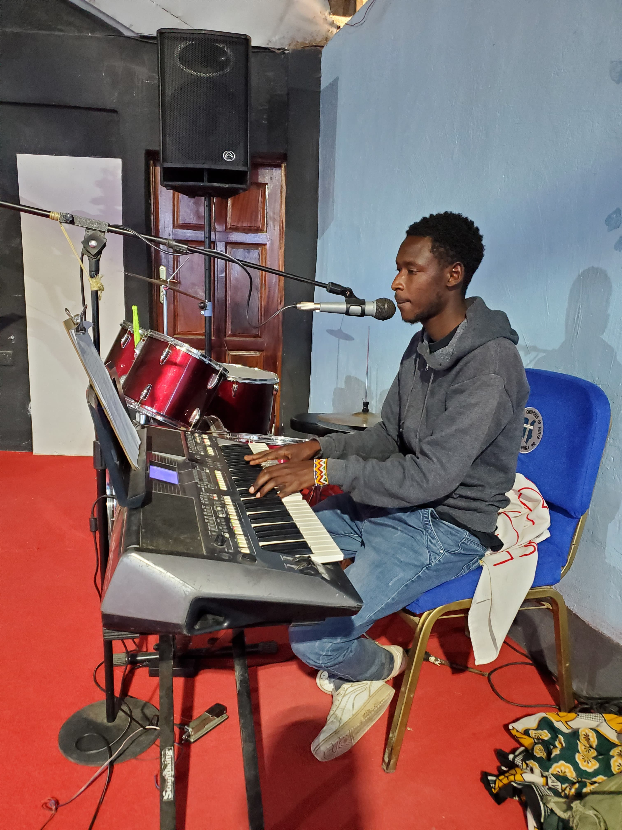
Music Achievement Church Instrumentalists and Pianists
Raised skilled church instrumentalists and pianists such as Daniel Teyie, Stephen Kandet, and Victor Leteipa.

Slide 3
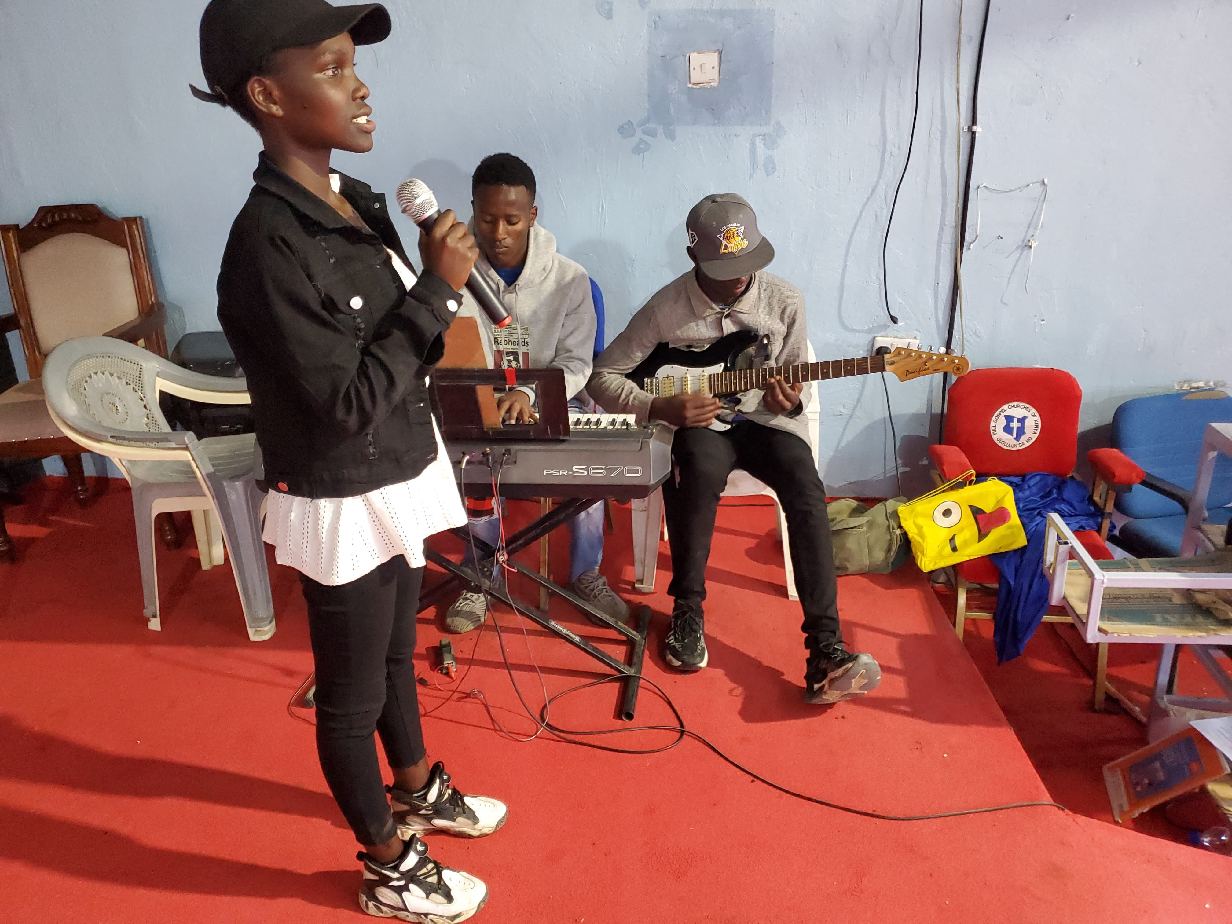
Nurtured Gospel Artists
Developed artists who contribute to church worship teams and choirs
- Active Artist: Riziki Jepchumba, a prominent gospel singer.
Pioneer: Linet Naini, lead vocalist and choir member at Full Gospel Churches of Kenya Ololulung’a Headquarters.

Slide 4
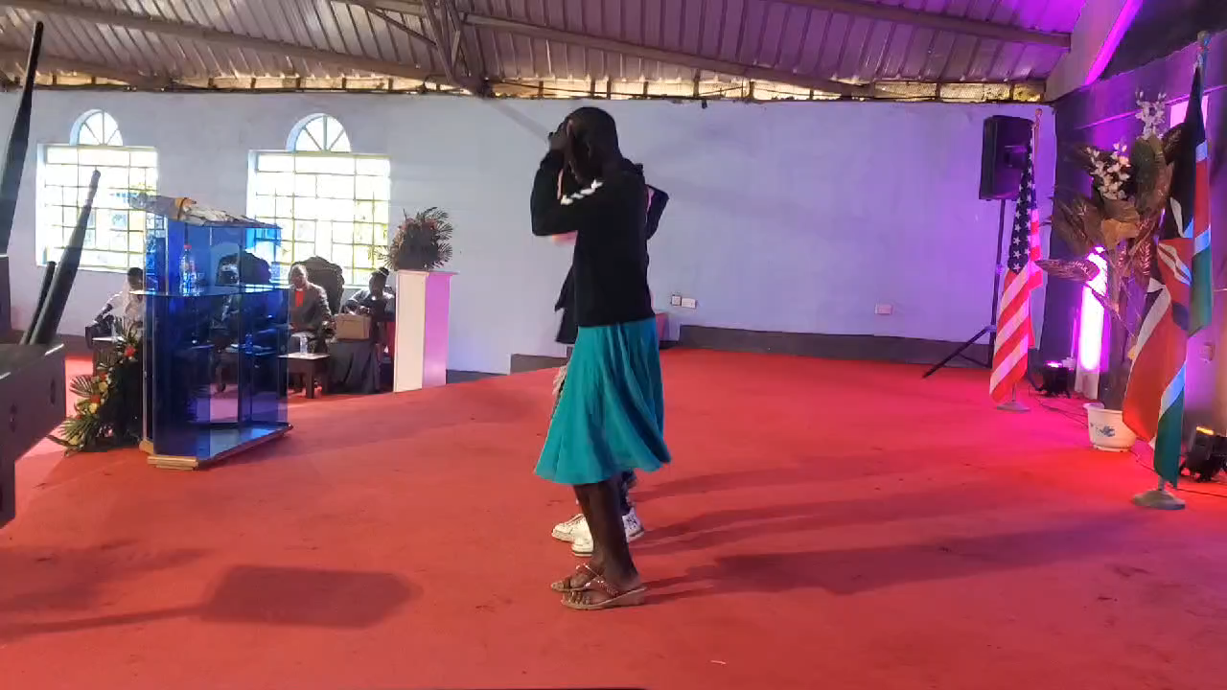
Youth Engagement and Outreach Reaching Youth and Children THROUGH MUSIC
Increased youth and children participation in church activities through talent development.
- Impact: Greater engagement and involvement in church programs.

Slide 5
Global Reach Social Media Impact
Social Media:
http://www.youtube.com/@Ahadi-G-Talents
Showcased talents on social media, reaching audiences worldwide.
Success: Expanded our influence and touched lives globally.

Slide 6
Participated in regional competitions with senior girls’ teams.
Achievements: Significant progress and recognition in sports.

Slide 7
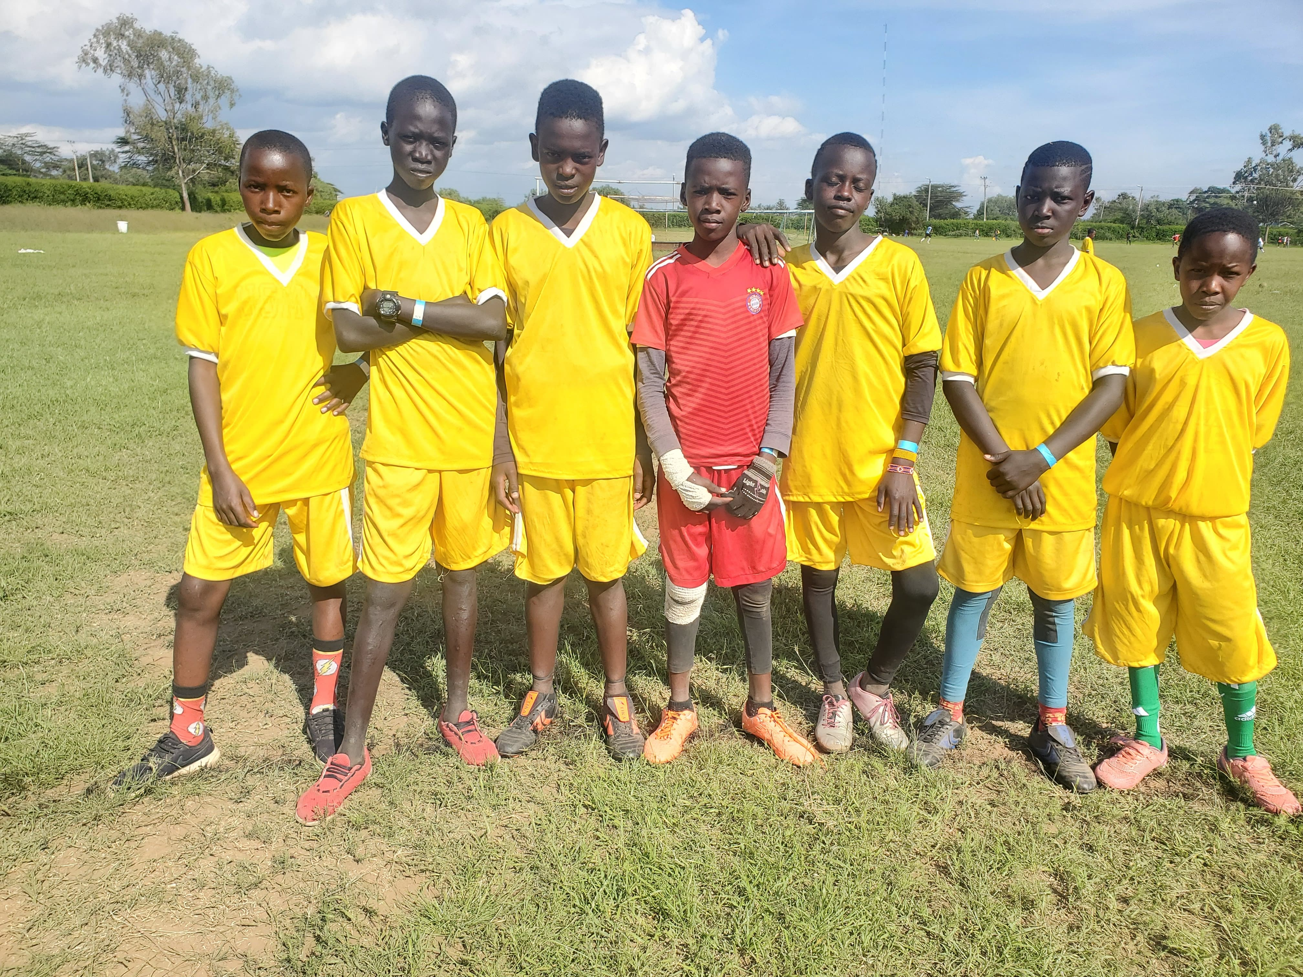
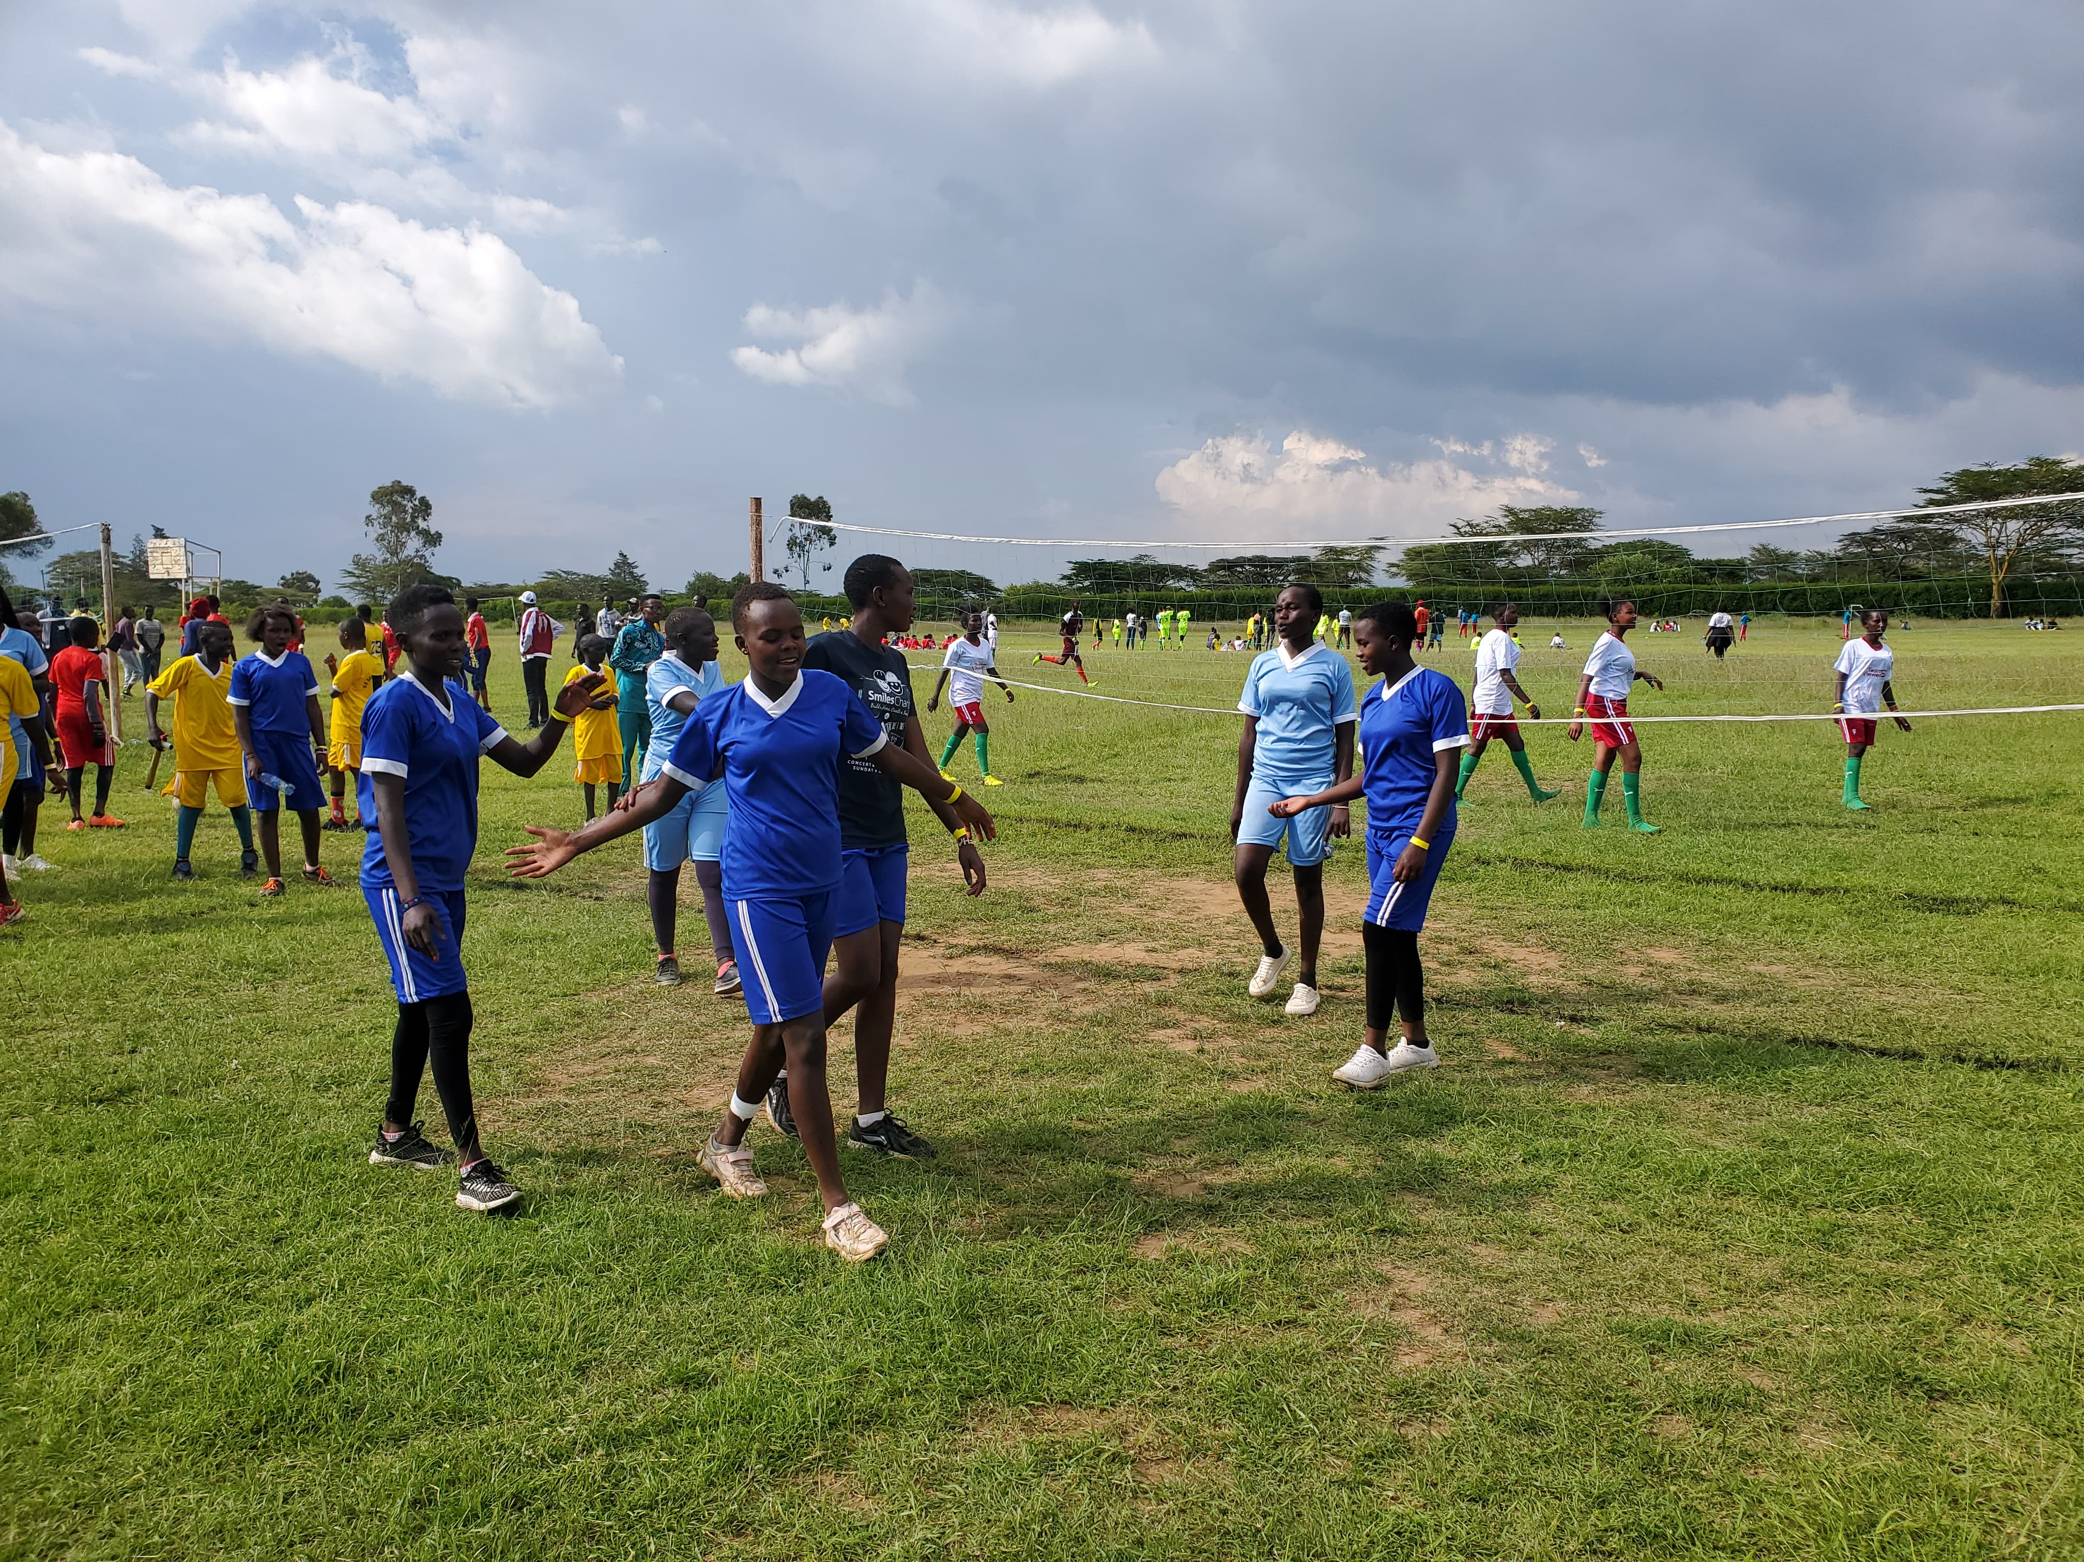
Sports Achievements
Success in Sports

Slide 8
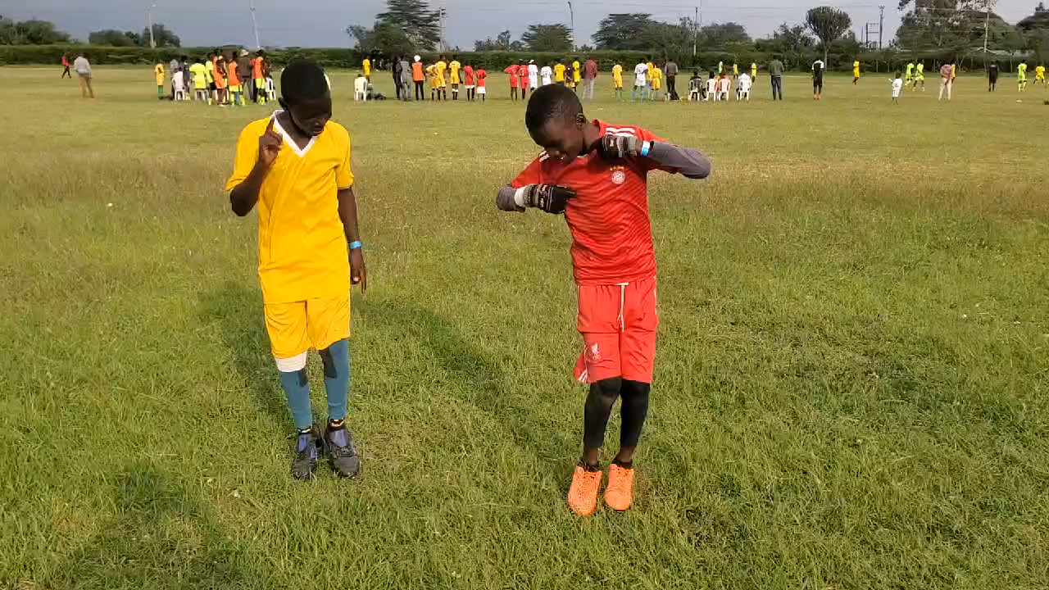

Slide 9
Future Goals
Continue nurturing talents and expanding our influence.

